Slide 1

Pension
Information Visualization
Shoham Shabat
Leorre Newman
Natalie Benisty
10.01.2022

Slide 2









Database
Information on existing pension companies in Israel from 2016-2020.
https://info.data.gov.il

Slide 3
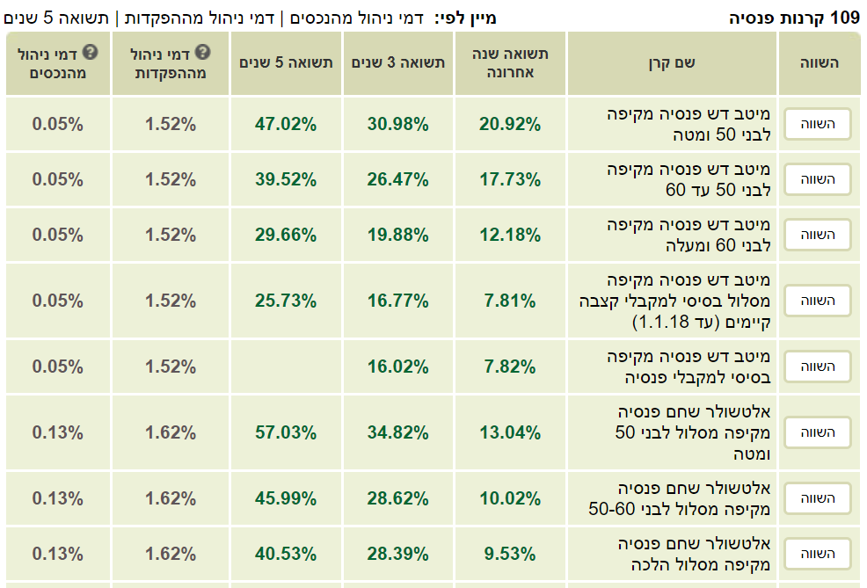
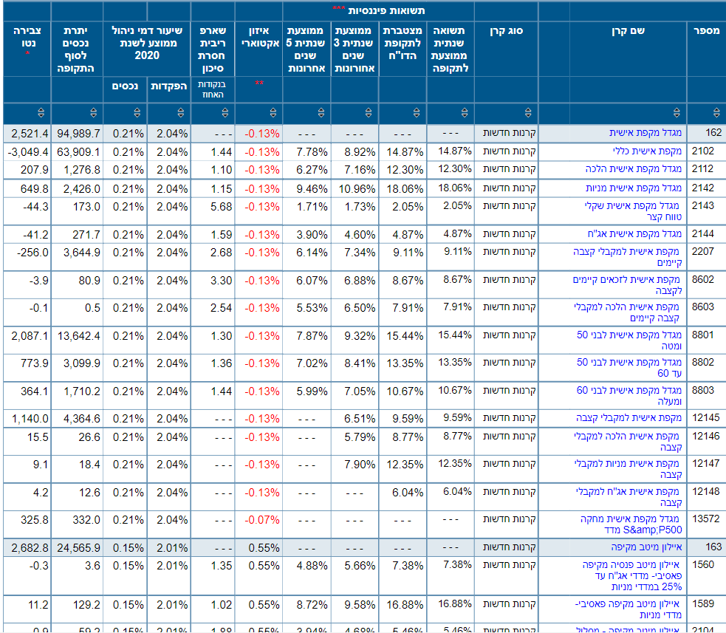
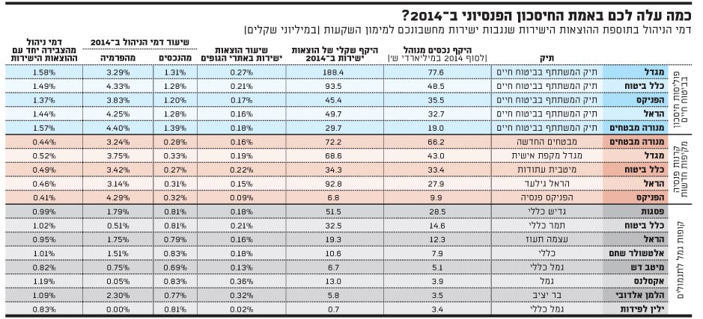
Previous works

Slide 4
Average Monthly Yield in 2020 per Company
What
Why
How
Average monthly yield in 2020 of all companies
Comparison between companies – general view
Diverging-Bar Chart

Slide 5
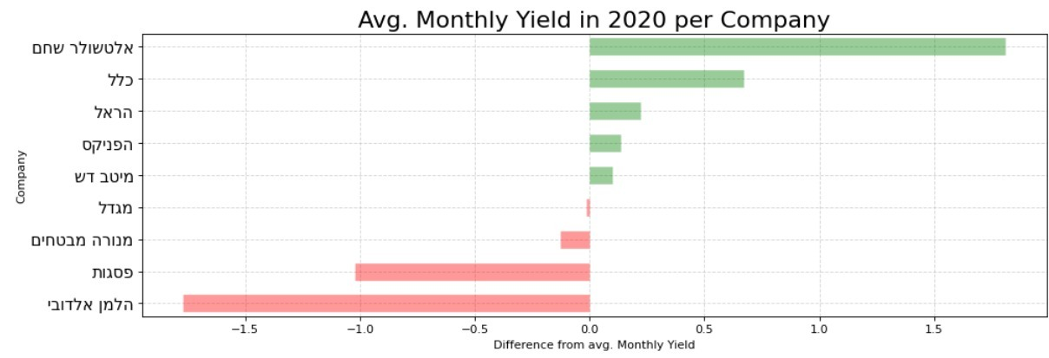

Slide 6
Average Monthly Yield per Company
What
Why
How
Average monthly yield per companies
Comparison between companies with drill-down options
Interactive graph – bar chart with line chart

Slide 7
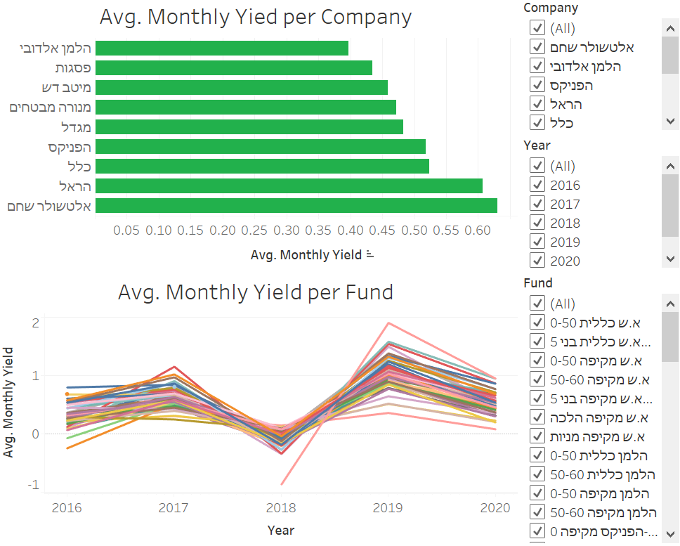

Slide 8
Annual Cumulative Yield vs. Avg. Annual Management Fee
What
Why
How
Relationship between Annual Cumulative Yield to Avg. Annual Management Fee
We want to see if higher Annual Management Fee leads to higher Annual Cumulative Yield
Scatter plot of last 3 years with different color to each company and classification of fund by different shape

Slide 9
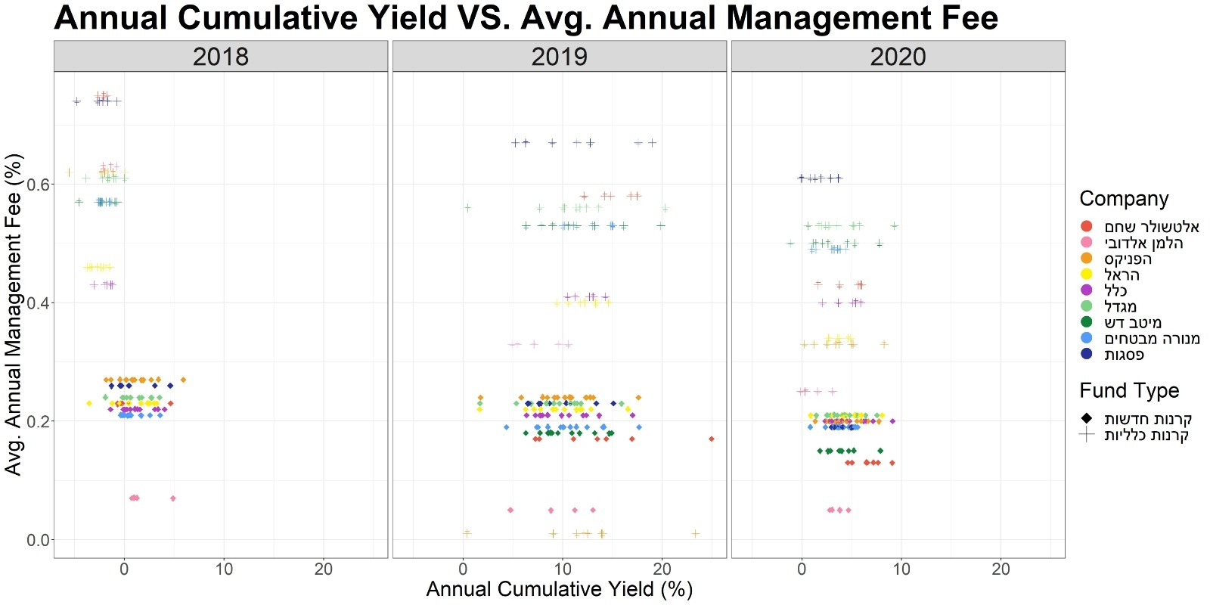

Slide 10
Liquid Assets Percentage Distribution by Company
What
Why
How
Distribution of liquidity of investment portfolios according to the various pension companies.
We would like to see in which company the liquidity index tends to be high, in order to see which company gives the highest and most reliable transparency.
Density plot of each company by facet.

Slide 11
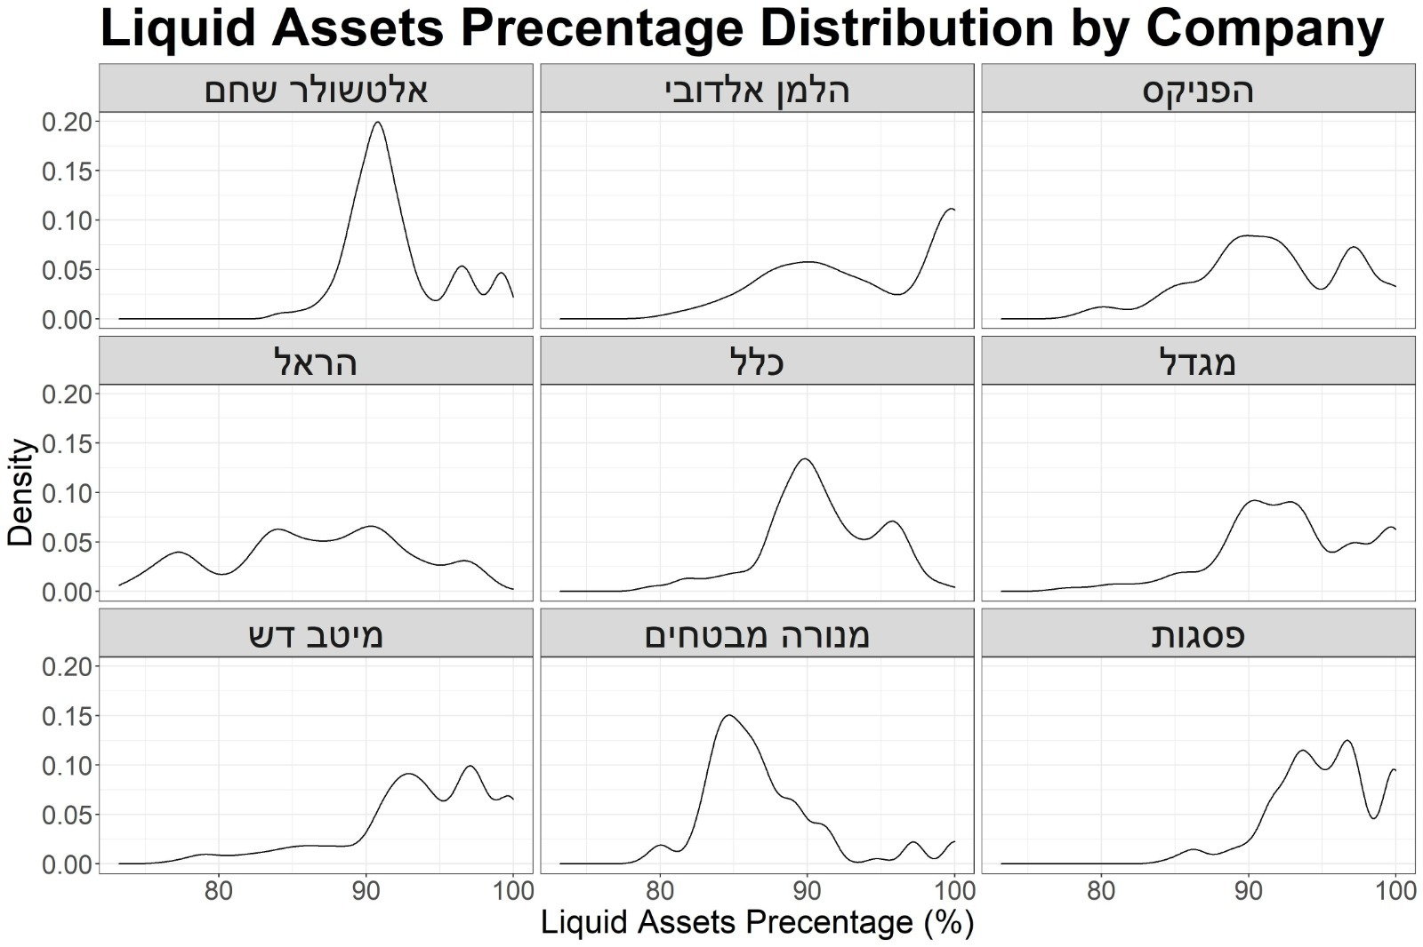

Slide 12
Boxplot of Alpha by Year & Fund Classification
What
Why
How
Distribution of Alpha measurement per companies
Comparison between the investment managers capabilities at the companies
Box-Plot of Alpha by company

Slide 13
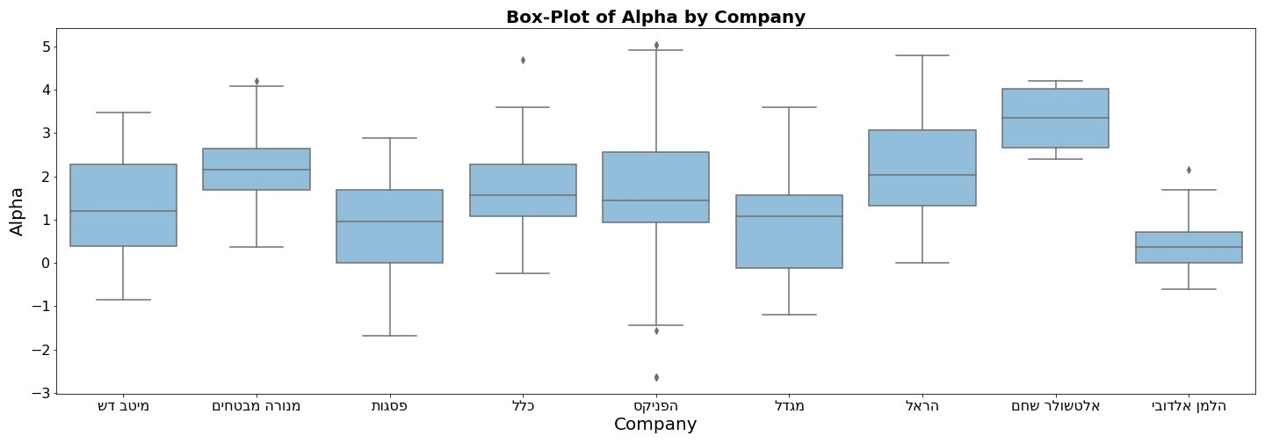
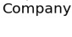

Slide 14
Radar Plot
What
Why
How
Six performance measurements (continues variables with different scales) per companies
Self investigation of the performance measurements and comparison between the companies
Interactive radar plot

Slide 15
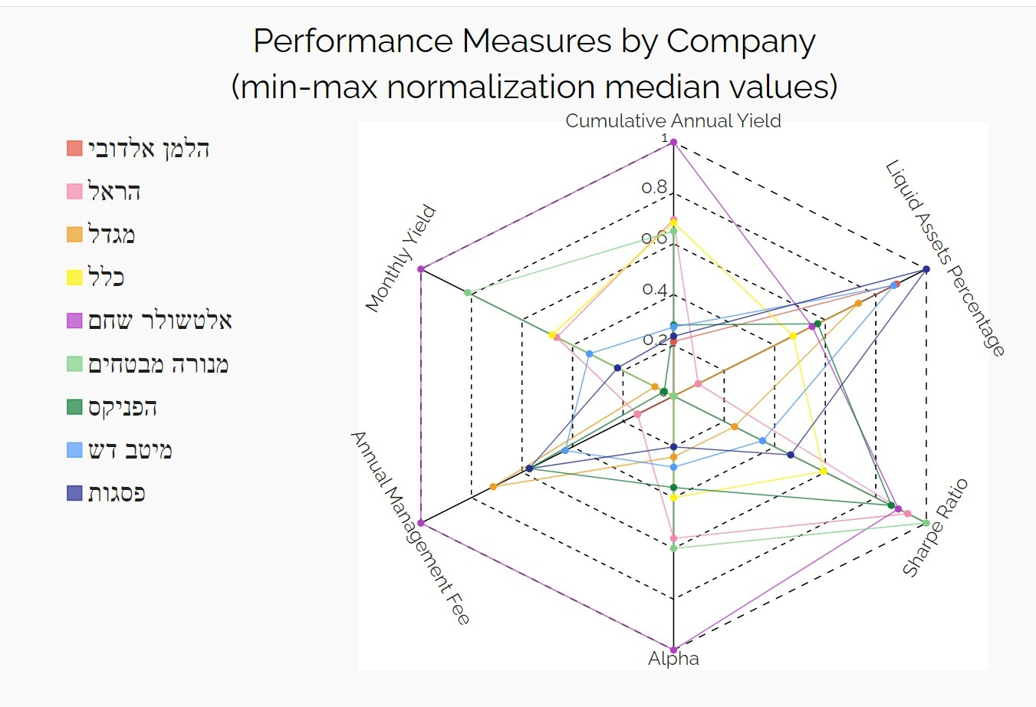

Slide 16

Thank you for listening

